Slide 1
BE ALL THAT YOU CAN BE!
A Series on
Realizing God’s Purpose for Your Life
John 15:1-3 – The Gardener’s Work
Preached by Dan Bridges on 16 July 2022 Amman International Church, Jordan (AmmanChurch.org) Uploaded by Dr. Rick Griffith • Jordan Evangelical Theological Seminary Files in many languages for free download at BibleStudyDownloads.org

Slide 2
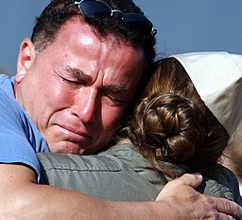
How do you feel about goodbyes?

Slide 3
How are goodbyes different if you know you’ll never see the person again?

Slide 4
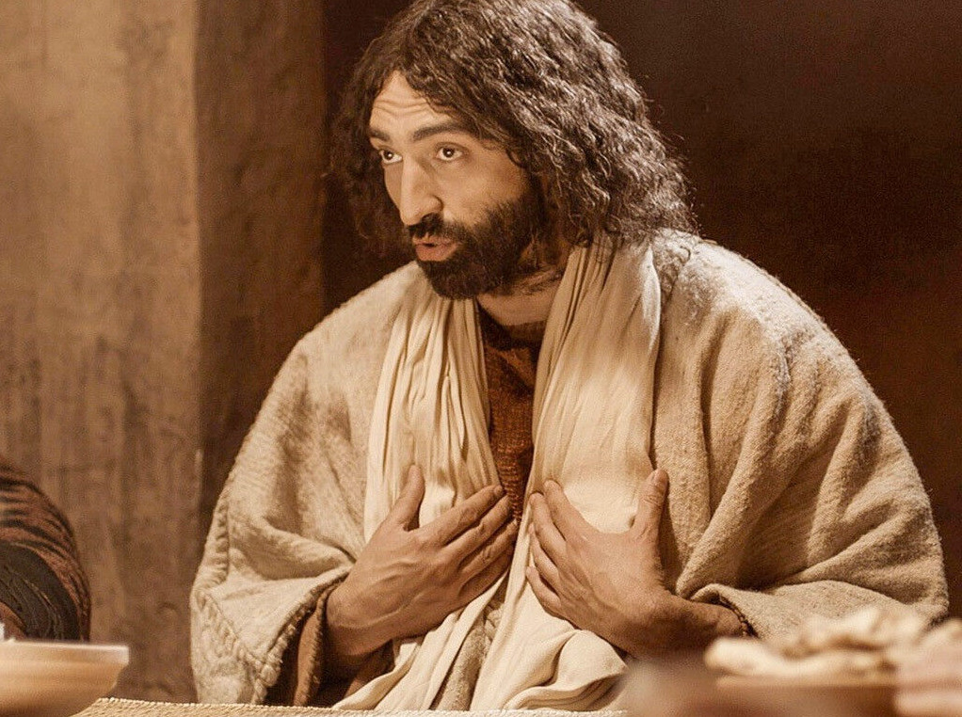
How did Jesus say Goodbye?
John 13-16
Upper Room Discourse
Jesus said goodbye by giving his disciples a vision for their future!
New relationships with each other
Doing greater things than him
A deeper relationship with him than they had ever experienced!

Slide 5
John 13-16
Upper Room Discourse
“In that day you will know that I am in my Father, and you in me, and I in you.”
John 14:20
What did this mean?
Discuss it – starting with “I in you”

Slide 6
John 13-16
Upper Room Discourse
“In that day you will know that I am in my Father, and you in me, and I in you.”
John 14:20
This “union” with Christ is the Key to God’s vision for your life! But how can we understand it?

Slide 7
John 13-16
Upper Room Discourse
“In that day you will know that I am in my Father, and you in me, and I in you.”
John 14:20
A word picture!
“I am the vine; you are the branches…”
John 15:5

Slide 8
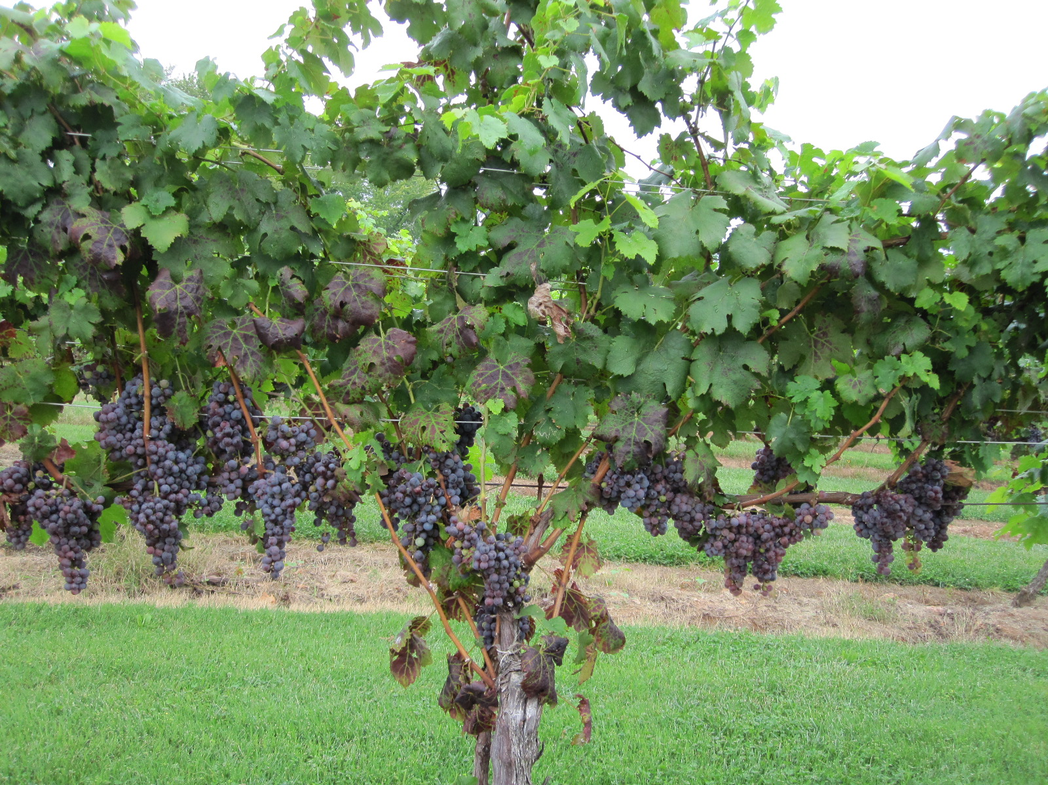
John 15:1-8
¹ “I am the true vine, and my Father is the gardener. ² He cuts off every branch in me that bears no fruit, while every branch that does bear fruit he prunes so that it will be even more fruitful. ³ You are already clean because of the word I have spoken to you.
⁴ Remain in me, and I will remain in you. No branch can bear fruit by itself; it must remain in the vine. Neither can you bear fruit unless you remain in me.”

Slide 9
John 15:1-8
⁵ “I am the vine; you are the branches. If a man remains in me and I in him, he will bear much fruit; apart from me you can do nothing. ⁶ If anyone does not remain in me, he is are like a branch that is thrown away and withers; such branches are picked up, thrown into the fire and burned. ⁷ If you remain in me and my words remain in you, ask whatever you wish, and it will be given you. ⁸ This is to my Father’s glory, that you bear much fruit, showing yourselves to be my disciples.”

Slide 10
John 15:1-3
¹ “I am the true vine, and my Father is the gardener. ² He cuts off every branch in me that bears no fruit, while every branch that does bear fruit he prunes so that it will be even more fruitful. ³ You are already clean because of the word I have spoken to you.”
What is God’s vision for our lives?
What does he do to bring that about?

Slide 11
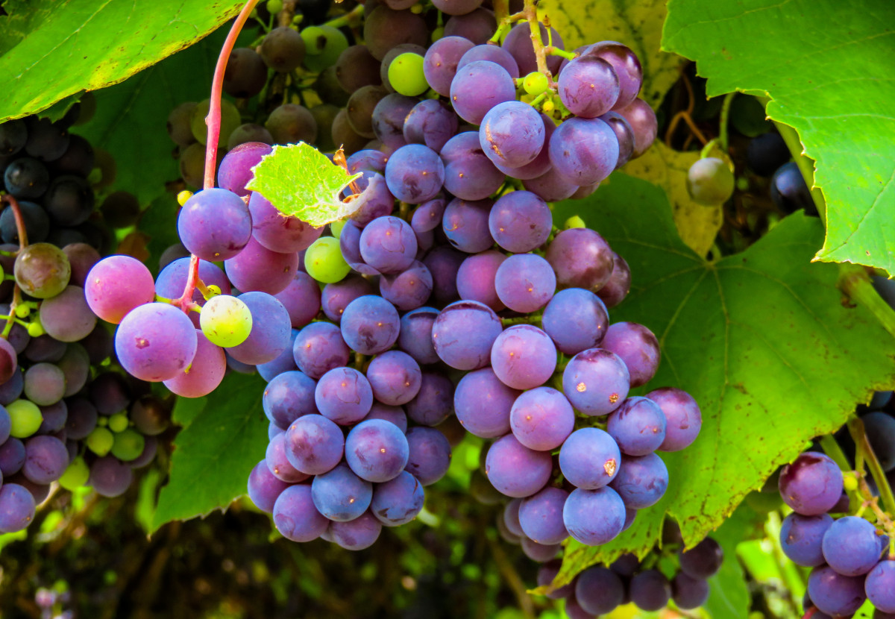
God’s Vision for Our Lives
FRUIT!!!

Slide 12
What is Fruit?
Fruit is used symbolically in the Bible to represent at least three different things:
Obedience / Righteous life – “Produce fruit in keeping with your repentance.” Matthew 3:8
Character – “The fruit of the Spirit is love, joy, peace, patience, kindness, …” Galations 5:22
New Believers – “All over the world, this gospel is bearing fruit and growing…” Colossians 1:6

Slide 13
So what is the fruit in John 15?
Obedience & Christ-like Character?
New believers?
How do we answer this?
Word study on “Fruit” in the NT and Book of John…
Conclusion: Both!

Slide 14
So what Fruit is God Working to Produce?
The Fruit of John 15:
Christ-like character and spiritual impact on others are the results of an intimate union with Jesus.

Slide 15
Replacing “Fruit” with that Definition:
¹ “I am the true vine, and my Father is the gardener. ² He cuts off every branch in me that [is not Christ-like in character and does not spiritually impact others], while every branch that [is Christ-like in character and spiritually impacts others] he prunes so that it will be even more [Christ-like in character and able to spiritually impact others].”
John 15:1-2

Slide 16
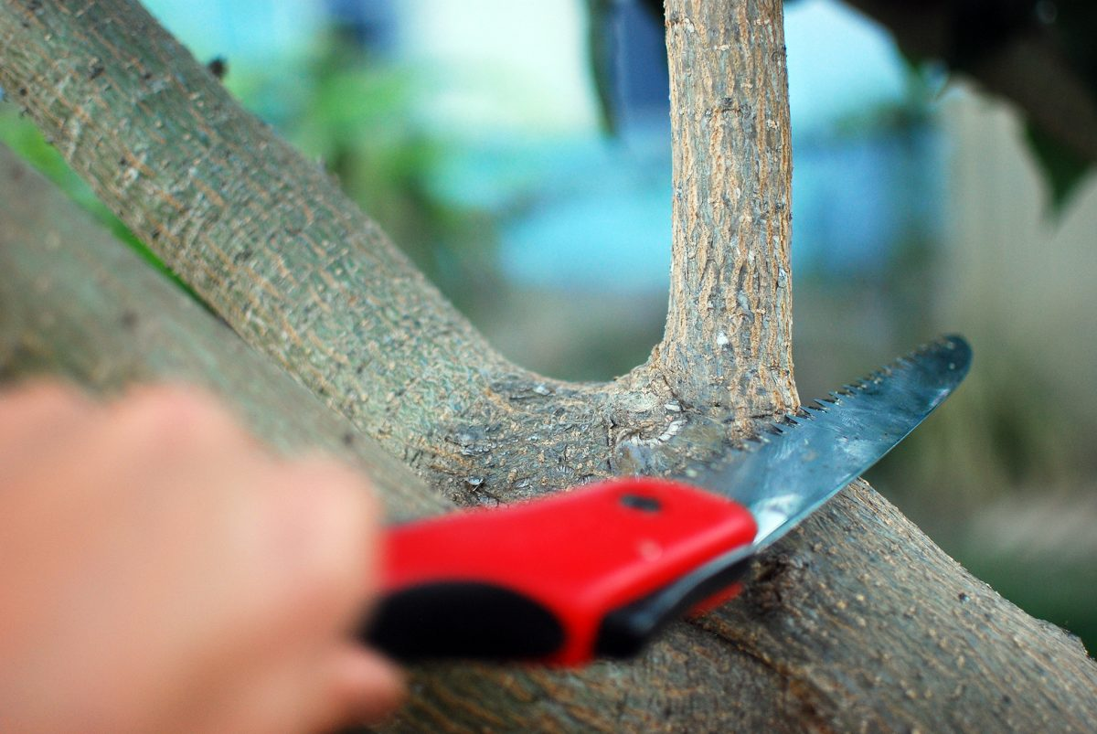
What does “cuts off” mean?
“He cuts off every branch in me that [is not Christ-like in character and does not spiritually impact others]”
This Photo by Unknown Author is licensed under CC BY-NC-ND

Slide 17
What does “cuts off” mean?
Is it referring to losing our salvation???
How “Christ-like” do you need to be?
The Gospel of John clearly teaches the eternal security of salvation
This Photo by Unknown Author is licensed under CC BY-NC-ND

Slide 18
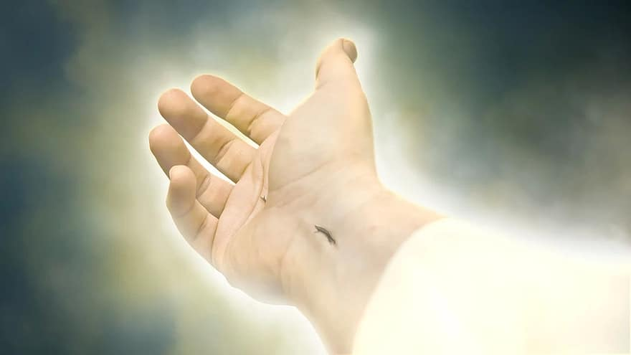
Our salvation is secure! True Believers…
Have become children of God (Jn 1:12)
Are born again (Jn 3:3,5,7-8)
Will not be cast out (Jn 6:37-39)
Are Christ’s sheep (Jn 10:14-16)
Have eternal life and cannot be snatched from Christ’s hand (Jn 10:27-28)
Are given to Jesus by the Father (Jn 17:6)

Slide 19
What does “cuts off” mean?
Maybe the unfruitful “branches” are not true believers
Examples:
Judas
Disciples who turned back (Jn 6:37-39)
“To the Jews who had believed in him he said, ‘If you hold to my teaching you are really my disciples’.” (Jn 8:31)
This Photo by Unknown Author is licensed under CC BY-NC-ND

Slide 20
What does “cuts off” mean?
Another Possibility:
“Cut Off” – Greek work “airo”
To take up, to lift up, to raise.
To take up and place on oneself, to take up and bear
To take up and carry away, meaning to take away
To take away, remove, with the idea of lifting away from, usually with the idea of violence and authority.
This Photo by Unknown Author is licensed under CC BY-NC-ND

Slide 21
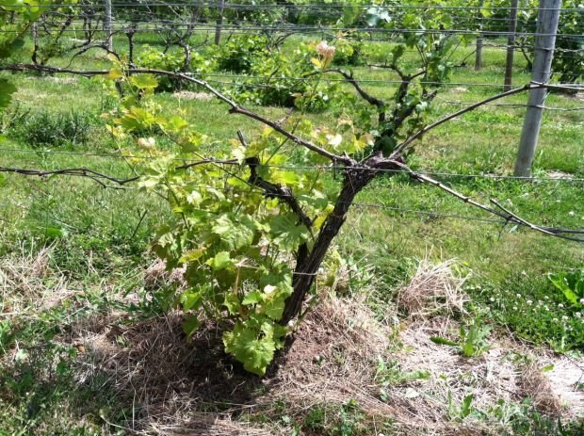
What does “cuts off” mean?
Another Possibility:
“Cut Off” – Gk “airo”
To lift up or raise

Slide 22
Replacing “Fruit” with that Definition:
¹ “I am the true vine, and my Father is the gardener. ² He [lifts up] every branch in me that [is not Christ-like in character and does not spiritually impact others], while every branch that [is Christ-like in character and spiritually impacts others] he prunes so that it will be even more [Christ-like in character and able to spiritually impact others].”
John 15:1-2

Slide 23
John 15:1-3
¹ “I am the true vine, and my Father is the gardener. ² He [lifts up] every branch in me that bears no fruit, while every branch that does bear fruit he prunes so that it will be even more fruitful. ³ You are already clean because of the word I have spoken to you.”
What is God’s role in making us Christ-like in character and able to impact others spiritually?

Slide 24
John 15:1-3
As the master gardener, God enables fruit in three ways:
God is in charge of our growth
God actively works for our growth
God spiritually enables our growth

Slide 25
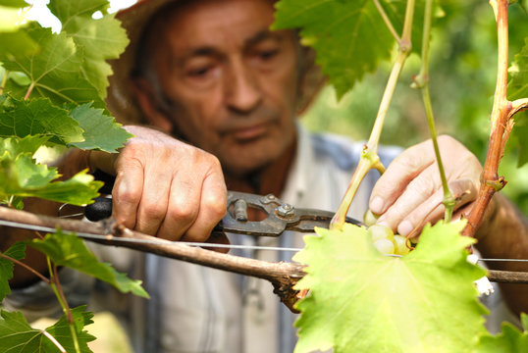
The Father is the Gardener –
He is in Charge of our Growth
God – The master gardener – skillfully and lovingly cares for us – in order that we might bear fruit!

Slide 26
God
God
Me
Me
Which of these pictures most accurately represents your picture of spiritual growth?

Slide 27
The Father is the Gardener –
He is in Charge of our Growth
God cares about your growth far more than you do!
He is not just waiting impatiently for you to change – he is taking an active role in it!

Slide 28
The Father is the Gardener –
He is in Charge of our Growth
God’s one goal: To make us completely like himself!
What sins are we willing to live with?
What have we given up on changing?
Are we expectant and ready to be used by God to spiritually impact others around us?

Slide 29
The Father is the Gardener –
He is in Charge of our Growth
To reach this goal, God wants to:
Bring about lasting, internal transformation.
Make us unrecognizable!
Our Response:
Let’s give up on our small ambitions!

Slide 30
John 15:1-3
As the master gardener, God enables life transformation in three ways:
God is in charge of our growth
God actively works for our growth
God spiritually enables our growth

Slide 31
He gives special care to branches that are fruitless
What does this look like for us?

Slide 32
Sometimes we don’t bear fruit because
of our brokenness
¹ Behold my servant, whom I uphold,
my chosen, in whom my soul delights …
² He will not cry aloud or lift up his voice,
or make it heard in the street;
³ a bruised reed he will not break,
and a faintly burning wick he will not quench…
Isaiah 42:1-3

Slide 33
Sometimes we don’t bear fruit because
of our brokenness
1 The Spirit of the Lord God is upon me, because the Lord
has anointed me to bring good news to the poor;
he has sent me to bind up the brokenhearted,
to proclaim liberty to the captives,
and the opening of the prison to those who are bound;
2 to proclaim the year of the Lord's favor…
to comfort all who mourn;
Isaiah 61:1-2

Slide 34
Sometimes we don’t bear fruit because
of our sin or our hard hearts
“⁵ And have you forgotten the exhortation that addresses
you as sons?
“My son, do not regard lightly the discipline of the
Lord, nor be weary when reproved by him.
⁶ For the Lord disciplines the one he loves,
and chastises every son whom he receives’.”
Hebrews 12:5-6

Slide 35
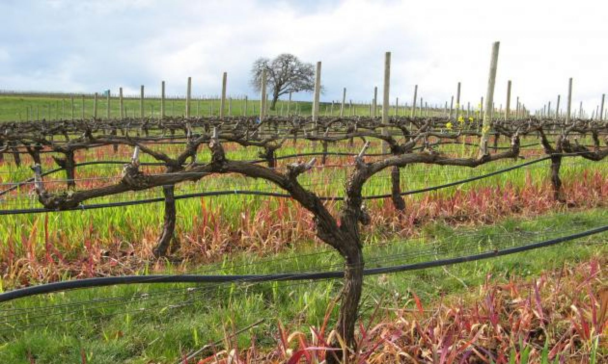
He prunes branches that are fruitful
For us, what does that mean?

Slide 36
God works to bring out our full potential!
“Endure hardship as discipline; God is treating you as sons… No discipline seems pleasant at the time, but painful. Later on, however, it produces a harvest of righteous-ness for those who have been trained by it.”
Hebrews 12:7,11

Slide 37
How does God Prune?
He removes (or calls us to give up) things that we love too much (e.g., money, career, alone time)
He removes things that we depend on too much (e.g., health, ministry success)
He tests us to stretch and grow our faith
Notes:
1. Giving up alone time for church potlucks, 2. Lack of ministry success, 3. Car insurance and accidents

Slide 38
How Will We Respond to Pruning?
Bitterness and anger
Faith and obedience in the midst of anguish

Slide 39
John 15:1-3
As the master gardener, God enables life transformation in three ways:
God is in charge of our growth
God actively works for our growth
God spiritually enables our growth

Slide 40
God Spiritually Enables Our Growth
¹ “I am the true vine, and my Father is the gardener. ² He cuts off every branch in me that bears no fruit, while every branch that does bear fruit he prunes so that it will be even more fruitful. ³ You are already clean because of the word I have spoken to you.”
John 15:1-3

Slide 41
What does it mean that they were “clean”?
… every branch that does bear fruit he prunes so that it will be even more fruitful. ³ You are already clean because of the word I have spoken to you.”
John 15:2b-3
Prune: Greek kathairo – to cleanse, purify, prune
Clean: Greek katharos – clean, pure, ceremonially
clean

Slide 42
What does it mean that they were “clean”?
At salvation, we become instantly ceremonially clean
“Whoever believes in the Son has eternal life…” John 3:36
“Whoever hears my word and believes him who sent me has eternal life and will not be condemned; he has crossed over from death to life.” John 5:24

Slide 43
At salvation, we receive spiritual life that enables organic growth!
“Because of his great love for us, God, who is rich in mercy, made us alive with Christ even when we were dead in transgressions...”
Ephesians 2:4-5

Slide 44
What does it mean that they were “clean”?
But that doesn’t mean we always live that way!
“…we have been made holy through the sacrifice of the body of Jesus Christ once for all.” Hebrews 10:10
“…by one sacrifice he has made perfect forever those who are being made holy.” Hebrews 10:14

Slide 45
What does it mean that they were “clean”?
katharos
The disciples were clean – they had spiritual life and were ready to produce spiritual fruit.
At the same time, God would continue to prune them to make them more fruitful.
kathairo

Slide 46
John 15:1-3
As the master gardener, God enables life transformation in three ways:
God is in charge of our growth
God actively works for our growth
God spiritually enables our growth

Slide 47
So are you Ready to Be all that You Can Be – To Embrace God’s Vision for your Life?
Do you have spiritual life?
Are you willing to let God be in charge – to give up your small ambitions and let him determine how far he wants you to go?
Are you responding in faith and obedience as he prunes – even in the midst of anguish?

Slide 48
Question for Next Week:
If God, as the gardener, is in charge of our growth, why do some people grow and produce more fruit than others?

Slide 49
Black

Slide 50
NT Preaching link at BibleStudyDownloads.org
Get this presentation for free!
Notes:
NT Preaching (np)

